Slide 1


Slide 2
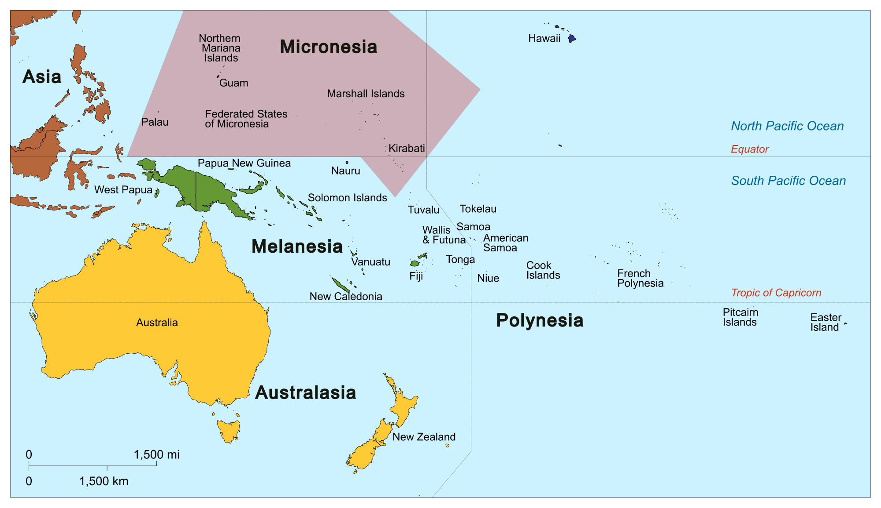

Slide 3
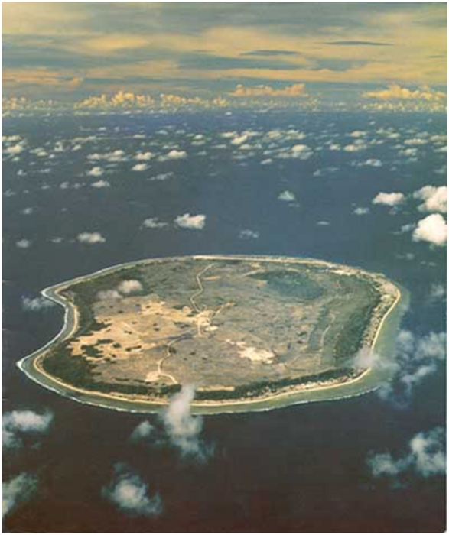
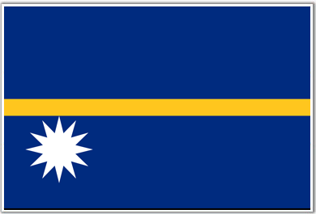
Notes:
] Nauru is a 21 square kilometres in size…you can drive the circumference in about 25 minutes
Nauru has a population of 10,000… this is definitely not a big market for an airline.

Slide 4
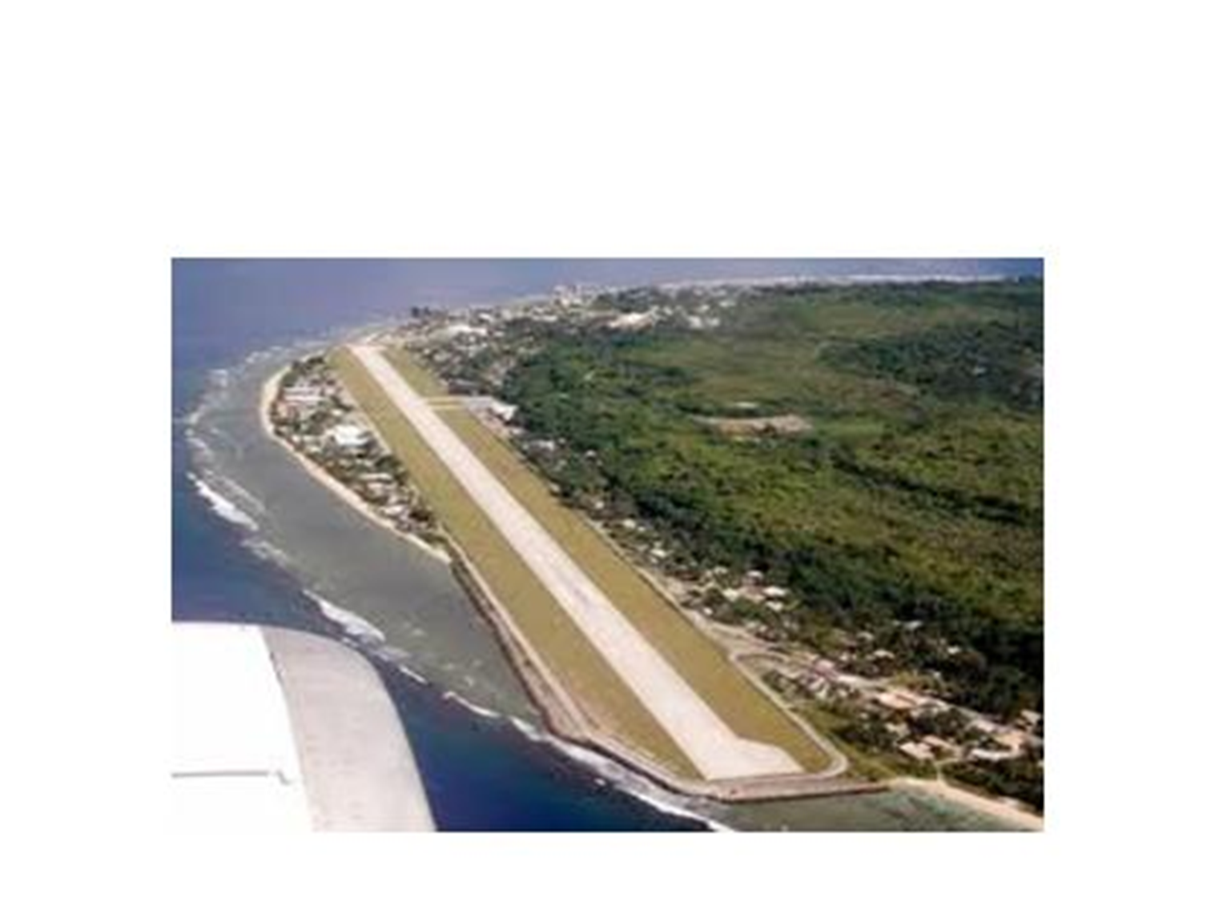
Notes:
With a small island, some creative thinking has to go into developing a runway long enough for jet aircraft….INTO the Water….
Initial development of Nauru’s landing facilities came out of the Japanese occupation in WW2.
After the war the strip was used by the local AFL competition (Nauruans are mad about AFL)
It was lengthened in the early 90’s…I suspect, when flights are not scheduled it still acts as a venue for AFL

Slide 5



Trading Names
Notes:
NAC has utilised 3 trading names during its history.
This is normally a NoNo…ask any branding expert…it’s a branding nightmare…but there were reasons for this
Air Nauru was the foundation of the airlines technical operations, even as they are today
First flights of Air Nauru occurred just after Nauru gained independence in 1968 ….Nauru – Honiara- Noumea- Brisbane

Slide 6

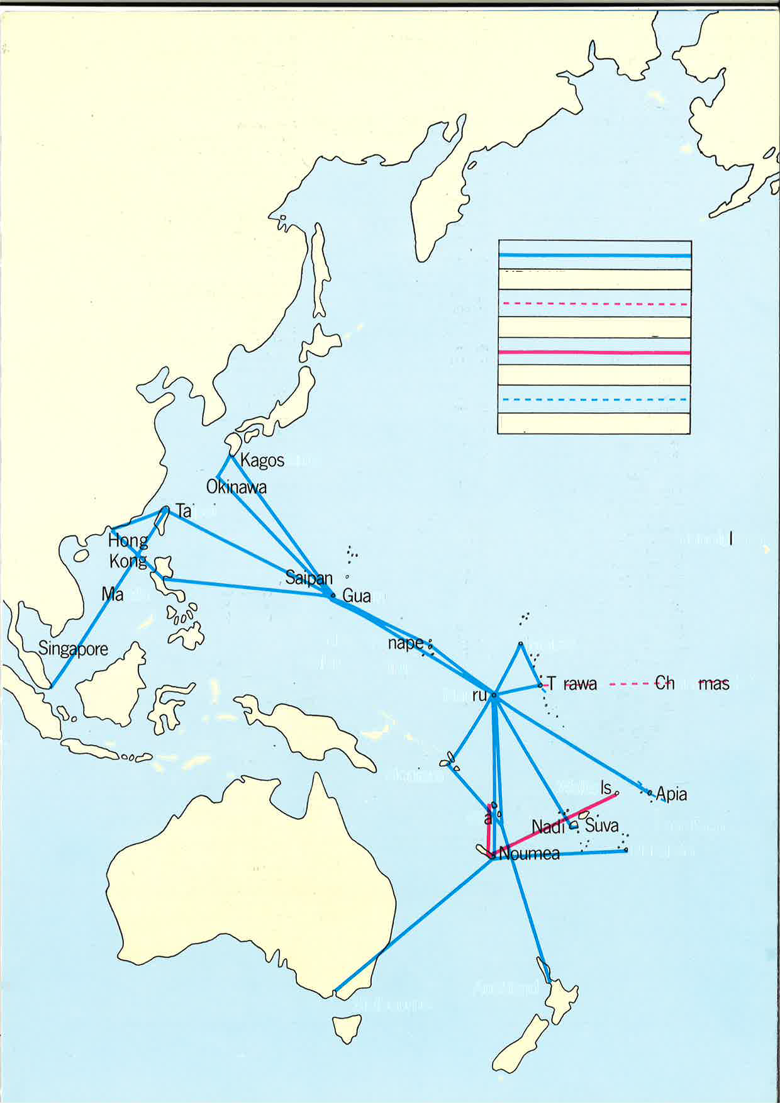
Notes:
As the years went on, the flying expanded quite spectacularly throughout the Central Pacific and Asia….this gave the airline great operational experience, but not great commercial experience, because the flights were largely empty….but it didn’t matter because all this development was underwritten by Nauru’s phosphate export wealth. HOWEVER, once that wealth started to decline, (which it did just as spectacularly in the mid to late 90’s) then all this flying was a MAJOR problem…it simply was not sustainable
In December 2005 at the height of Nauru’s financial woes, aircraft VH-RON, Air Nauru’s one and only remaining aircraft, was the subject of re-possession…THUD, there is no more ‘sinking feeling for an Airline CEO to have the keys taken of your last plane

Slide 7
4 Point restructure
Identity re-invention / co-operative partnerships
Diversification – commercial network
Fleet expansion/rejuvenation
Expanded/Diversified business model

Slide 8
Identity Re-invention
Notes:
NAC has utilised 3 trading names during its history.
This is normally a NoNo…ask any branding expert…it’s a branding nightmare…but there were reasons for this
Air Nauru was the foundation of the airlines technical operations, even as they are today
First flights of Air Nauru occurred just after Nauru gained independence in 1968 ….Nauru – Honiara- Noumea- Brisbane

Slide 9
Let
Your Airline
Be
Notes:
So we conceived the concept of Our Airline in mid 2006 on the premise of a new-found co-operation amongst a family of smaller airlines.
Let Our Airline be Your Airline….that is let us do the work that don’t have the time or capability of doing…let us fly, on your behalf

Slide 10





New Partners
Notes:
…..Secured an aircraft through “donor support to Nauru”….New partnerships had to be established…wasn’t easy because our reputation over losing our plane to the sheriff was way down, but we still had our Australian AOC, and the partners needed us for our operational experience

Slide 11
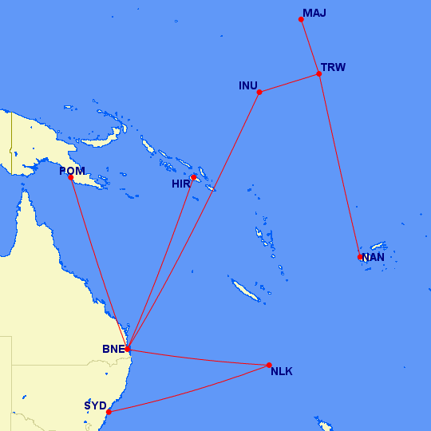
Notes:
…thru our new found partners provided a variety of charter work to support their operations

Slide 12
4 Point Restructure
Identity re-invention / co-operative partnerships
Diversification – commercial network
Fleet expansion/rejuvenation
Expanded/Diversified business model

Slide 13
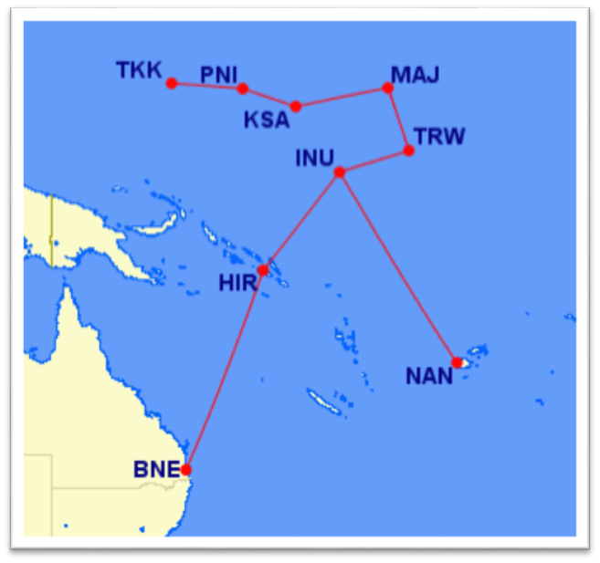

Slide 14
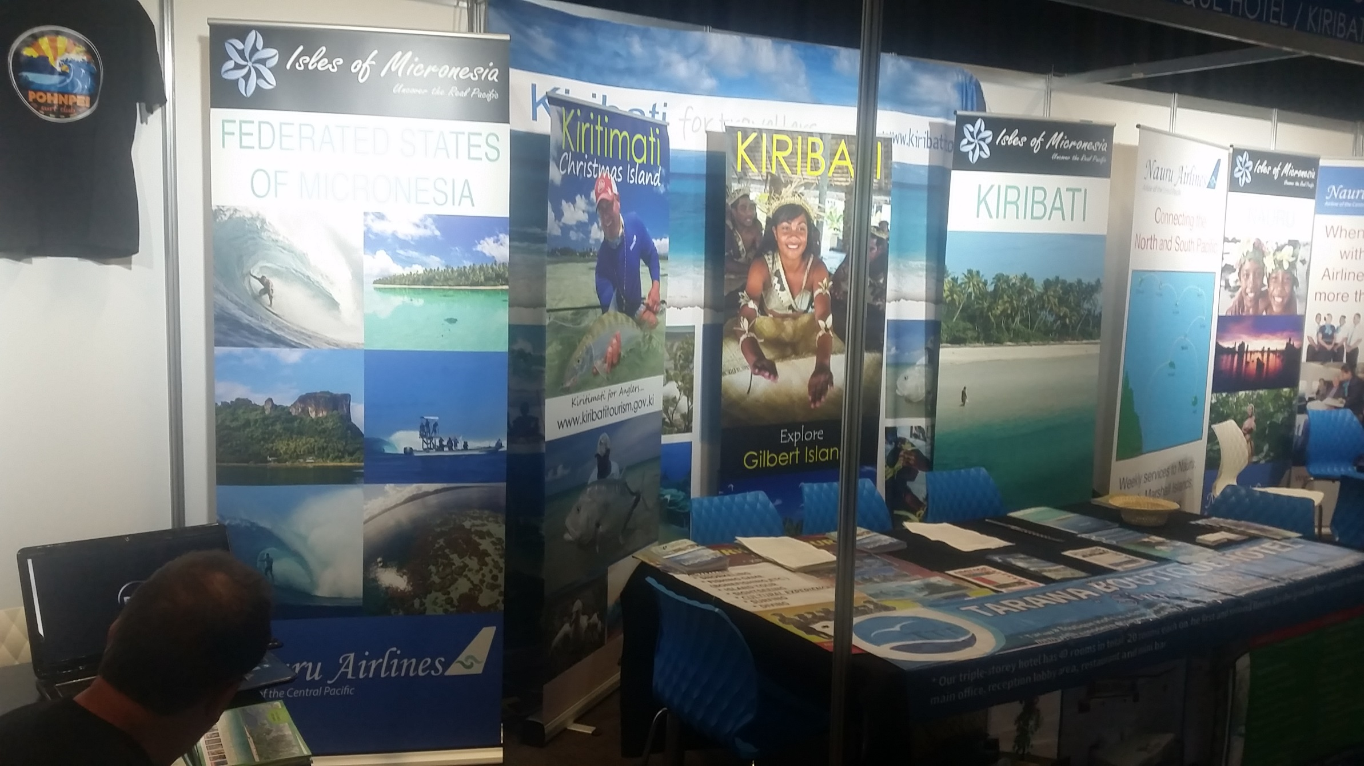

Slide 15
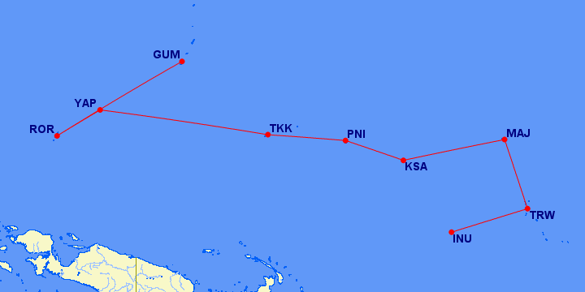
?

Slide 16
4 Point Restructure
Identity re-invention / co-operative partnerships
Diversification – commercial network
Fleet expansion/rejuvenation
Expanded/Diversified business model

Slide 17
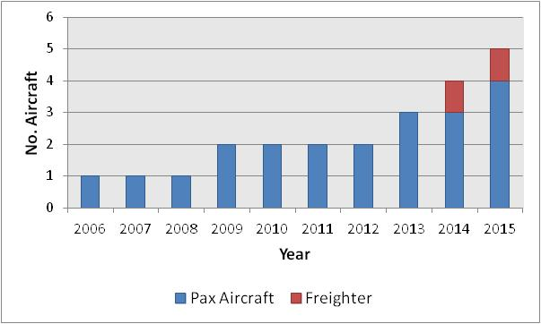
More aircraft required
Our fleet is 100% Classic Boeing 737-300
Notes:
With the additional flying that has been built up as late, we have now a fleet of 5 planes, four passenger aircraft and the full freight aircraft

Slide 18
Registration | Type | Year of Manufacture | Into Service for Nauru Airlines
VH-PNI | Passenger | 1997 | October 2013
VH-ONU | Passenger | 1998 | October 2014
VH-YNU | Passenger | 1999 | January 2015
VH-XNU | Passenger | 1999 | January 2016
VH-VLI | Freighter | 1993 | July 2014

Slide 19
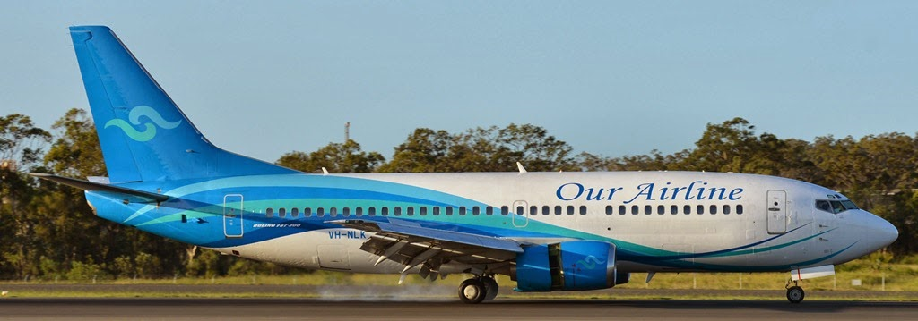
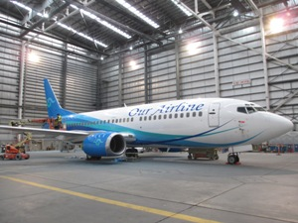
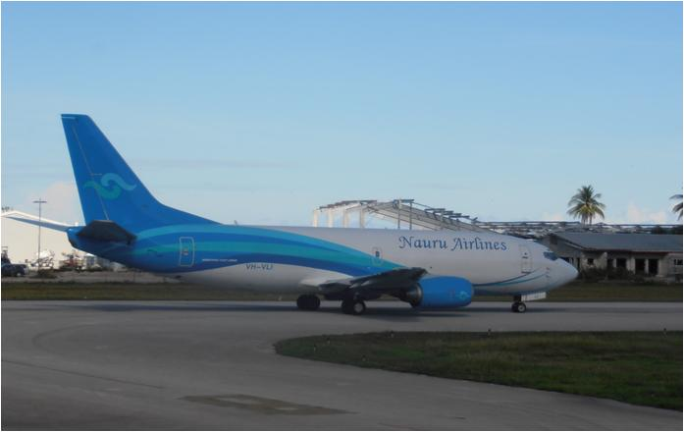

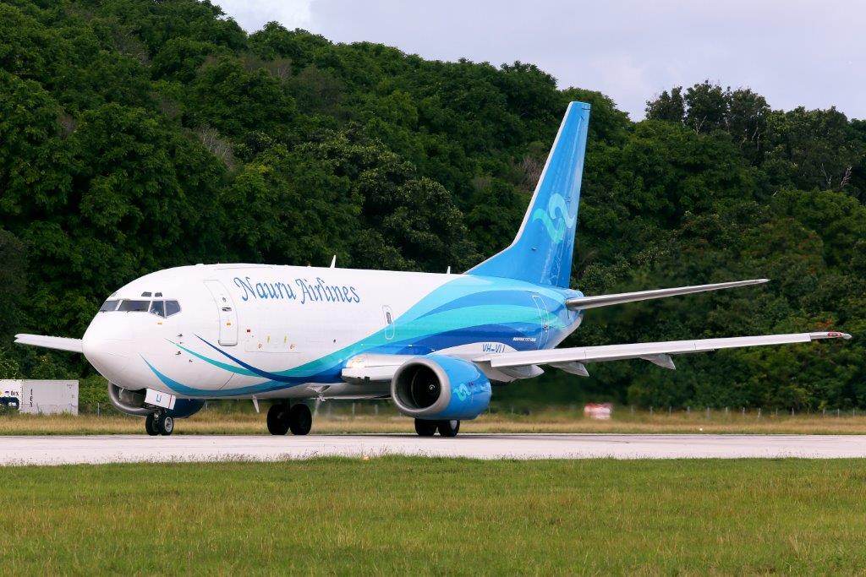
Our Fleet of Boeing 737-300’s
VH - NLK
VH – PNI
VH-VLI
VH - ONU
VH - YNU
Notes:
…and there is the ‘fleet’…

Slide 20
4 Point Restructure
Identity re-invention / co-operative partnerships
Diversification – commercial network
Fleet expansion/rejuvenation
Expanded business model

Slide 21
Expanded Business Model
Freighter Aircraft
Travel Agency – Our Travel
Engineering Business Unit

Slide 22
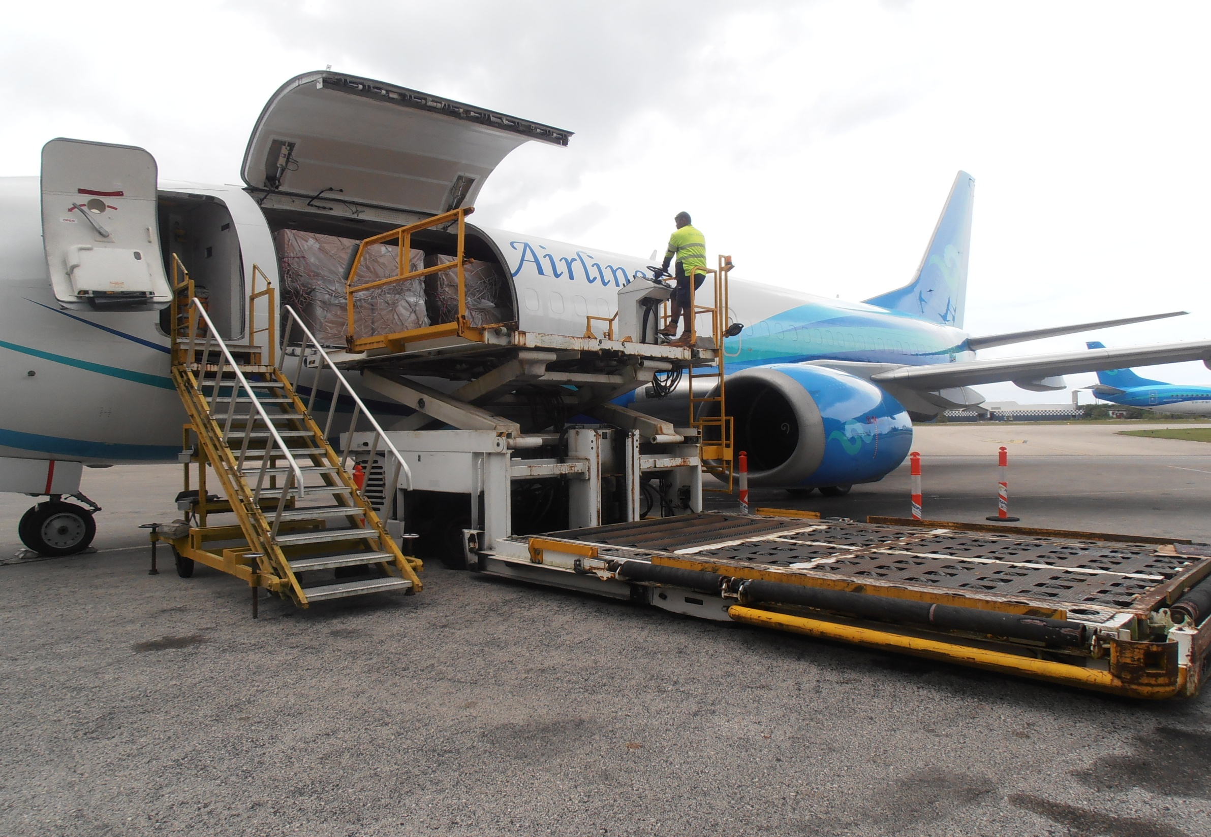
Freighter
Notes:
The freight work is also a new opportunity for the airline in provisioning Nauru and neighbours with its import needs, especially perishable food stuffs and medical supplies and equipment.
Also the export from selected countries of fresh tuna for the major world markets

Slide 23
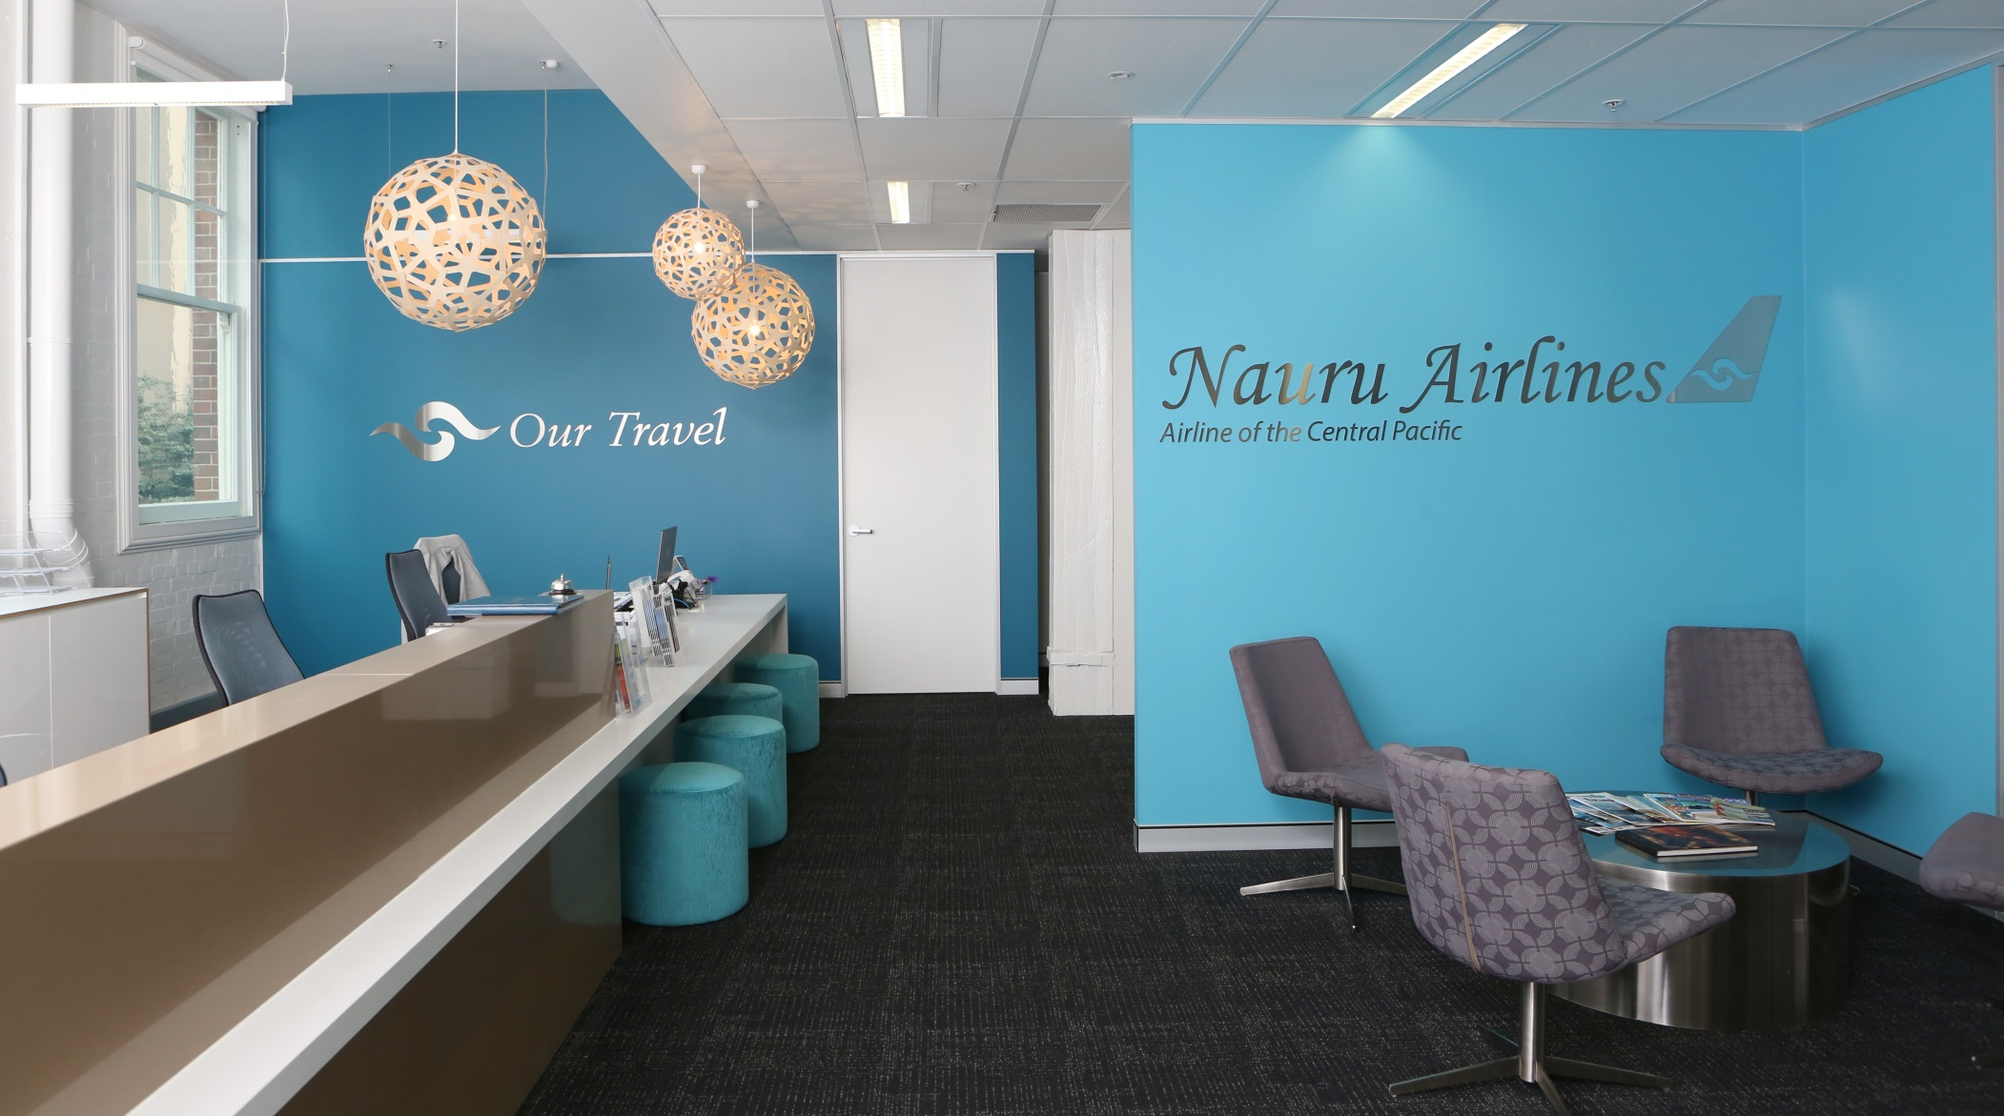
Our Travel
Notes:
….We also continue to develop the travel agency….

Slide 24
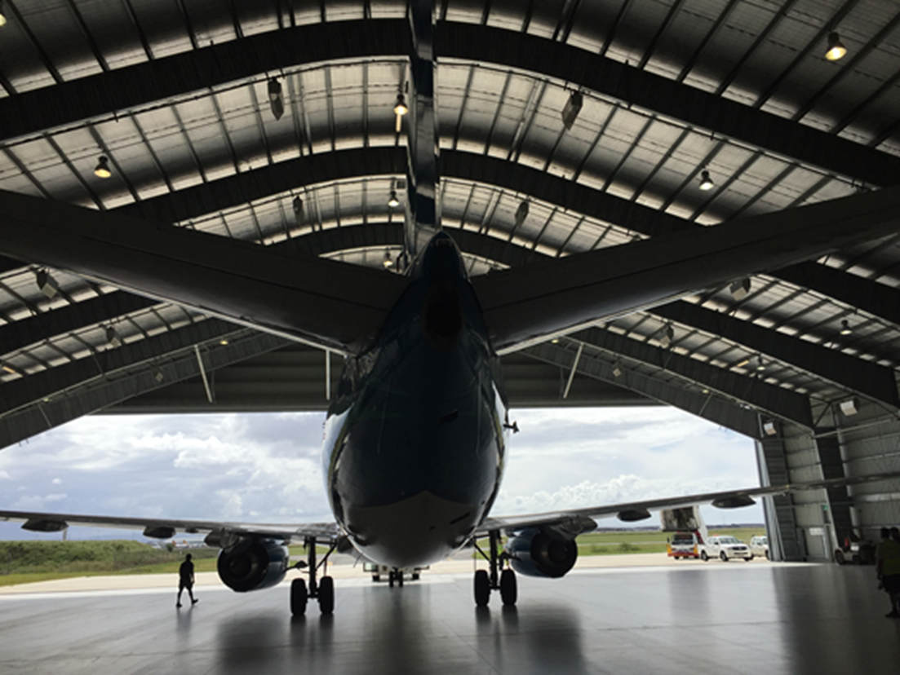
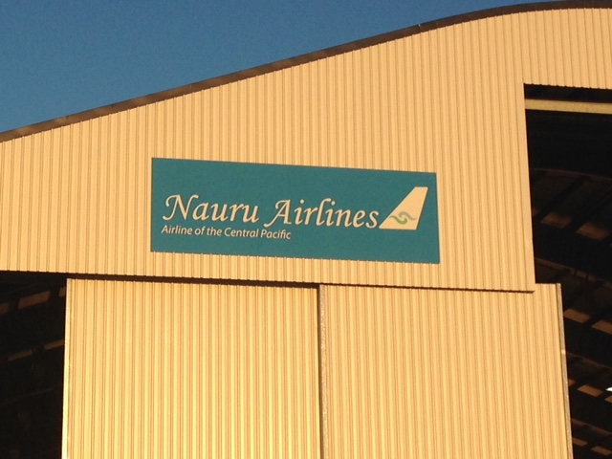
Engineering Business Unit

Slide 25
Our Mission
To provide safe, reliable, cost effective and efficient air services to the people of Nauru and its neighbours
  Visiting friends and family
  Medical transfers both people and urgent medical supplies
  Carriage of Freight including regular supplies of perishable goods
  Transporting children to schools and universities within the region
  Enabling businesses to meet and trade beyond the region
  Explore short-term/long-term charter opportunities
  Continue to expand Our Travel and Engineering Business Unit

Slide 26
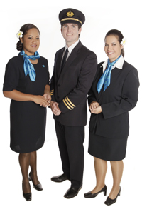
Thank you

